Slide 1
MLB Postseason Roster Web Application
Matt Gates, Tanner Graham, Cade McPartlin

Slide 2
Table of Contents
MongoDB (Database)
Flask (API)
Bootstrap (GUI)
Application Preview

Slide 3
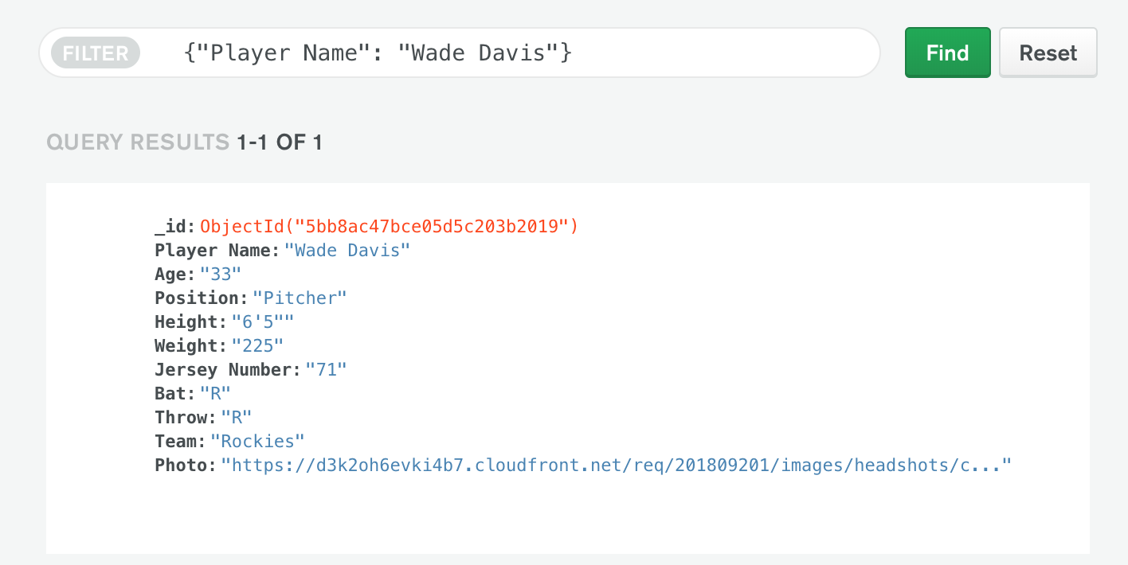
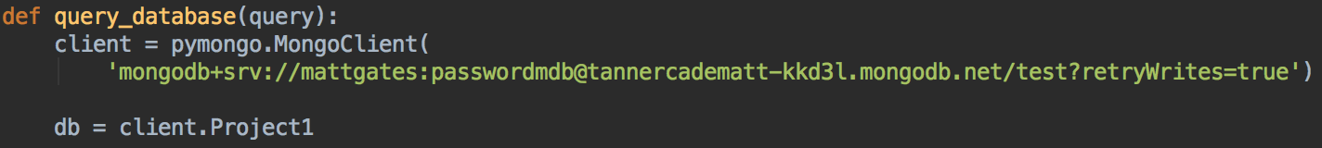
MongoDB Atlas
Setup database
Add items to the database
Link Python to MongoDB with PyMongo
Query MongoDB for database items

Slide 4


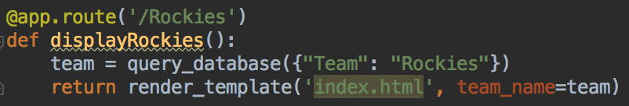
Python
Flask for creation of application routes
Pymongo for connection to database
Query information from database
Pass list of each team to Flask route

Slide 5

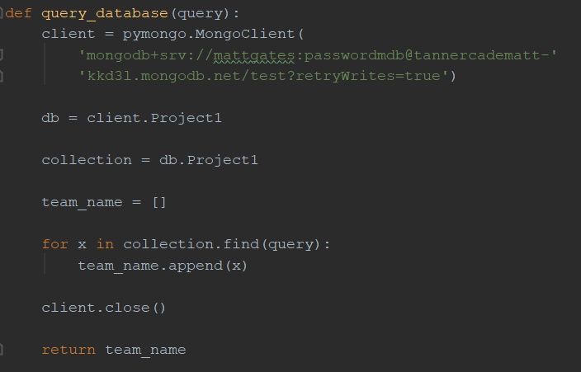

Python cont.
Database Query

Slide 6
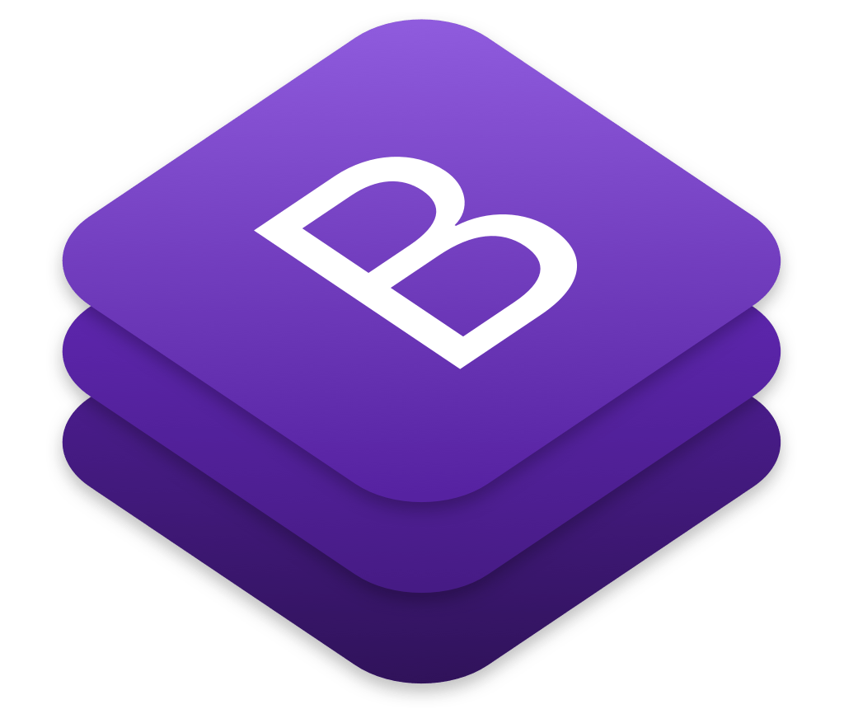
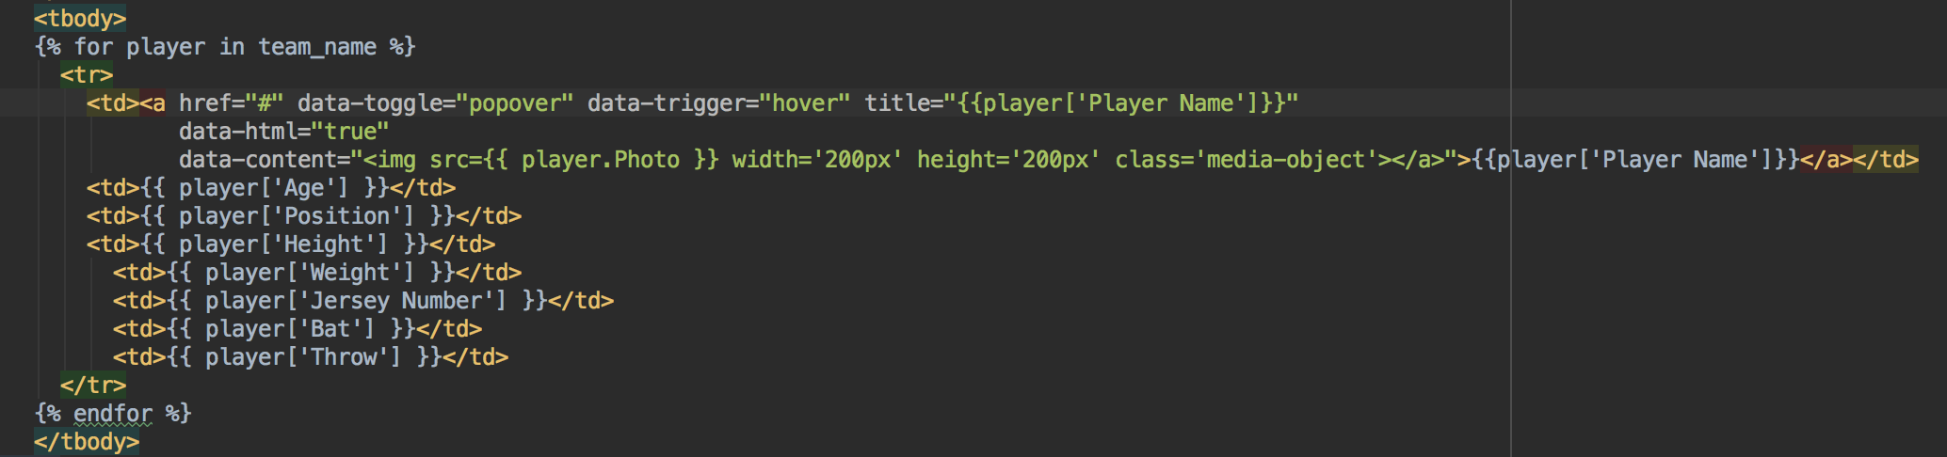
Bootstrap GUI
Bootstrap for major UI design
Jinja to dynamically generate information from database
Jinja - template engine for Python; Flask implements it
JavaScript for popover feature

Slide 7
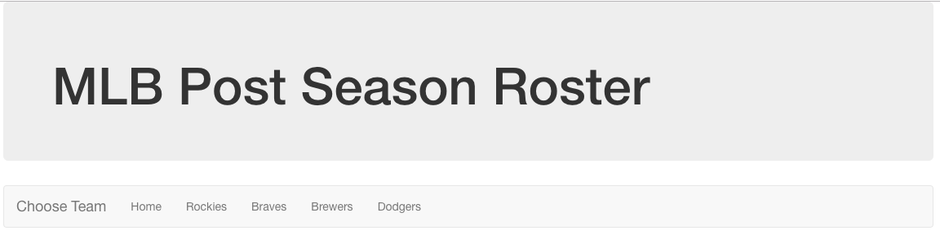
Application Preview

Slide 8
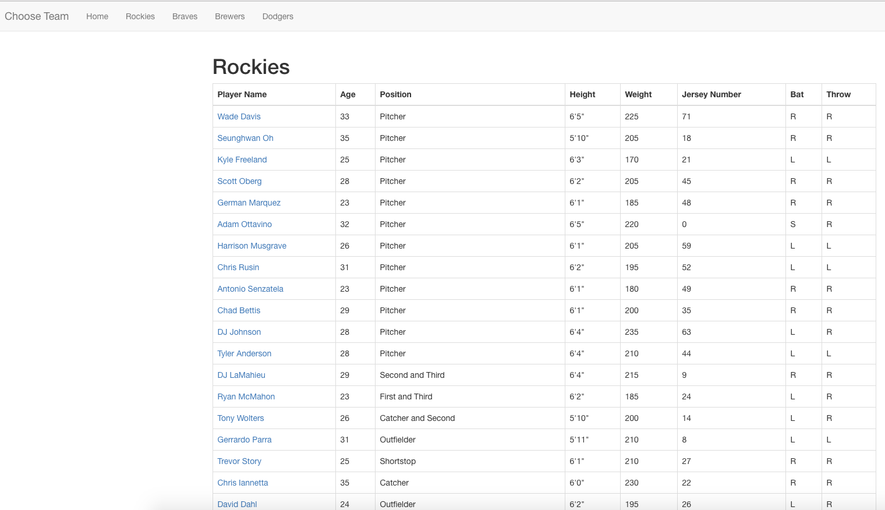
Application Preview

Slide 9
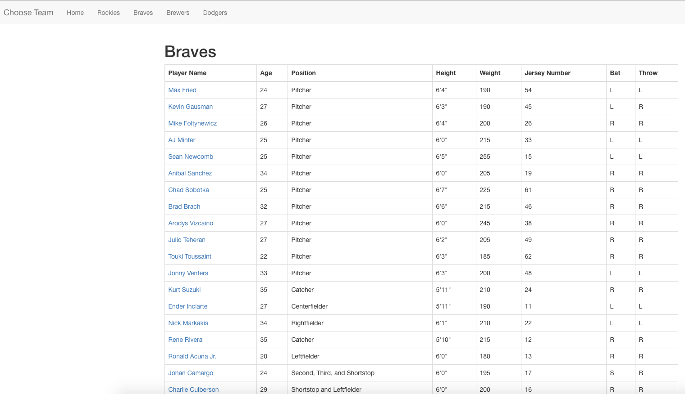
Application Preview

Slide 10
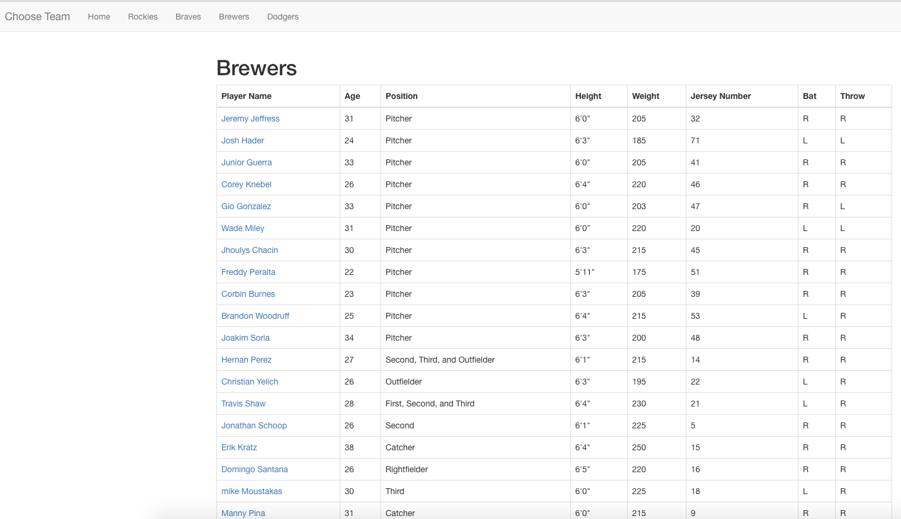
Application Preview

Slide 11
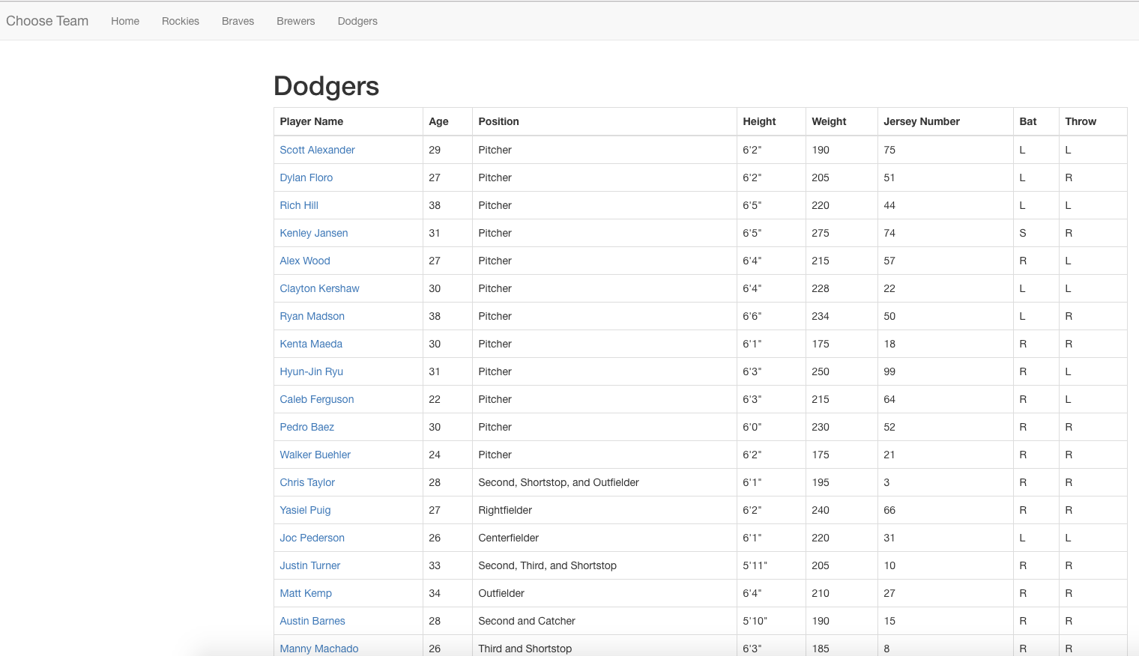
Application Preview

